Slide 1
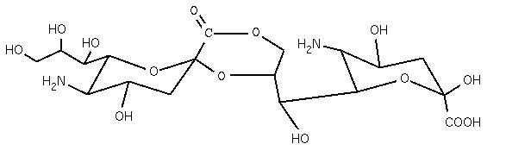
A
Fragment of a sequence with a lactonized sialic acid
B
GlycoCT{HashCode}
RES
1b:a-dgro-dgal-non-2:6|1:a|2:keto|3:d
2s:amino
3b:a-dgro-dgal-non-2:6|1:a|2:keto|3:d
4s:amino
LIN
1:1d(5-1)2n
2:1o(8-2)2d
3:1o(9-1)2d
4:3d(5-1)4n
Residue list
Linkage section

